Slide 1
Network Environment Management
Managing Router Startup and Configuration

Slide 2
Router Power-On Boot Sequence
Perform power-on self-test (POST).
Load and run bootstrap code.
Find the Cisco IOS Software.
Load the Cisco IOS Software.
Find the configuration.
Load the configuration.
Run the configured Cisco IOS Software.
Notes:
Emphasize: In a later slide, there is a very detailed flowchart of the router startup process.

Slide 3
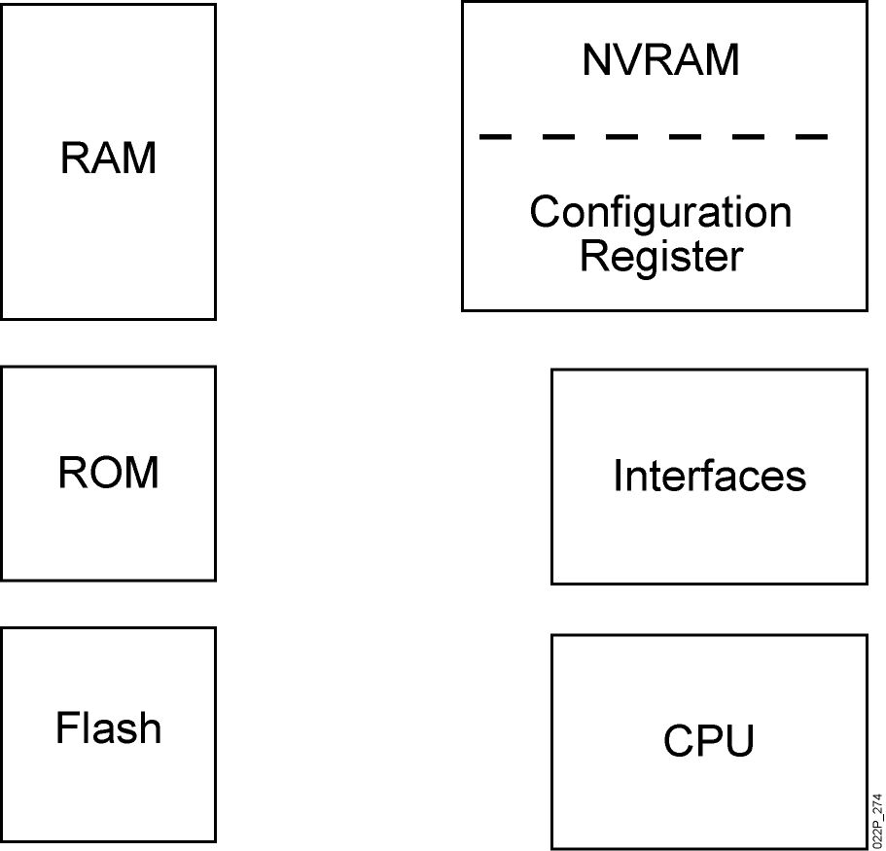
Router Internal Components
Notes:
Note:
RAM—Packet buffers, running configurations, running Cisco IOS
ROM—POST, ROM monitor, baby Cisco IOS (Rxboot)
NVRAM—Backup configurations, config register
Flash—Cisco IOS
Flash memory is nonvolatile. It behaves like a file system. It is more expensive than NVRAM. It is readable and writeable. The 2500 routers run from Flash. If it is running Cisco IOS from Flash, then the Flash is in the readable state. Use the boot system command to boot Cisco IOS from a TFTP server so the 2500 can run from RAM if you need to write or erase Flash online.

Slide 4
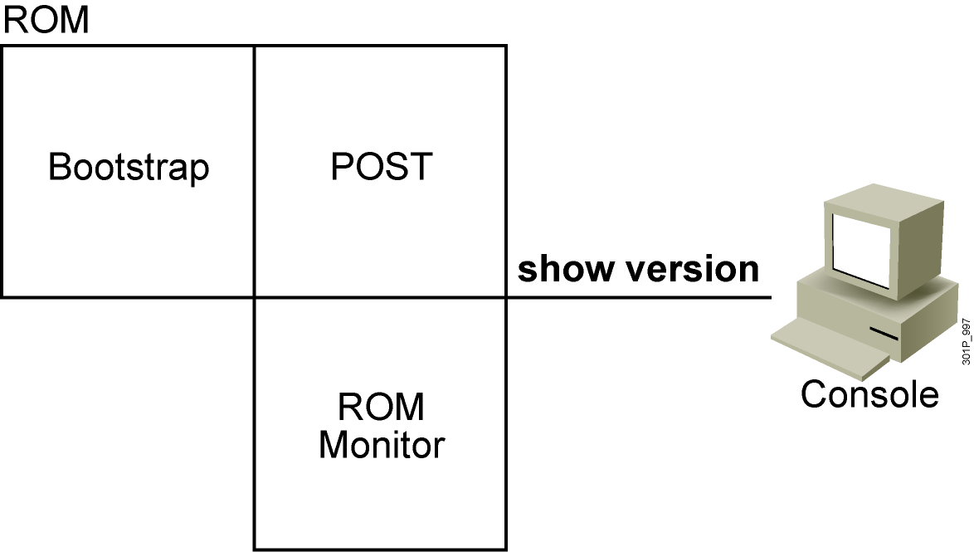
ROM Functions
Contains microcode for basic functions
Notes:
Note: Mini Cisco IOS is the Rxboot mode.
One use of the ROM monitor is for password recovery. From ROM monitor, you can set the config register to 0x2142 so the NVRAM will be ignored during startup.

Slide 5
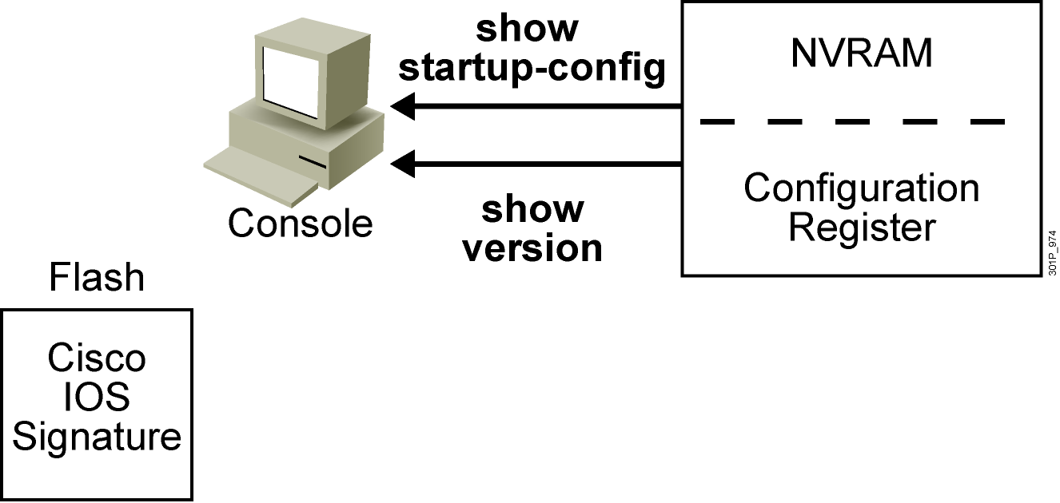
Finding the Cisco IOS Image
Order of search:
1. Checks configuration register
2. Parses configuration for boot system command
3. Defaults to first file in flash memory
4. Attempts to boot from network server
5. Boot helper image
6. ROMMON
Notes:
Note: There is a detailed flowchart of the router startup process on the next slide.

Slide 6
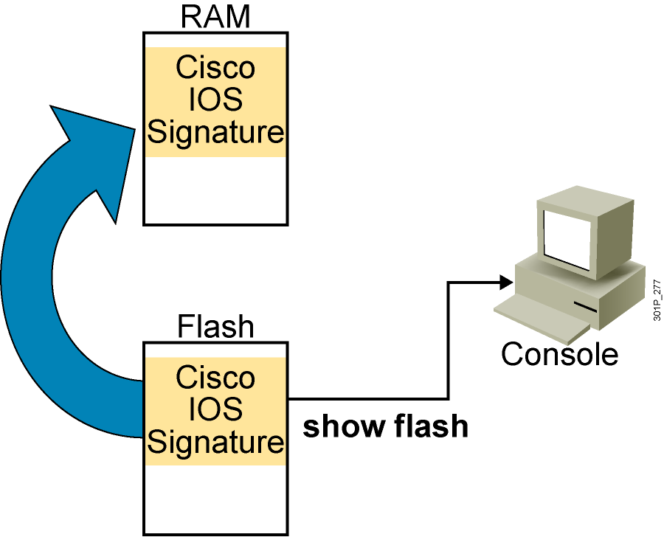
Loading the Cisco IOS Image from Flash Memory
The flash memory file is loaded into RAM.
Notes:
Note: The 2500 series routers do not operate this way. The 2500 series routers normally run Cisco IOS from Flash. The Cisco IOS in Flash is not compressed but it is relocatable. Relocatable means the Cisco IOS image can be run from Flash or from RAM.
The 2500 can run from RAM if you use the boot system tftp command to boot the Cisco IOS image.
The Rxboot mode is also run from RAM on the 2500 routers.

Slide 7
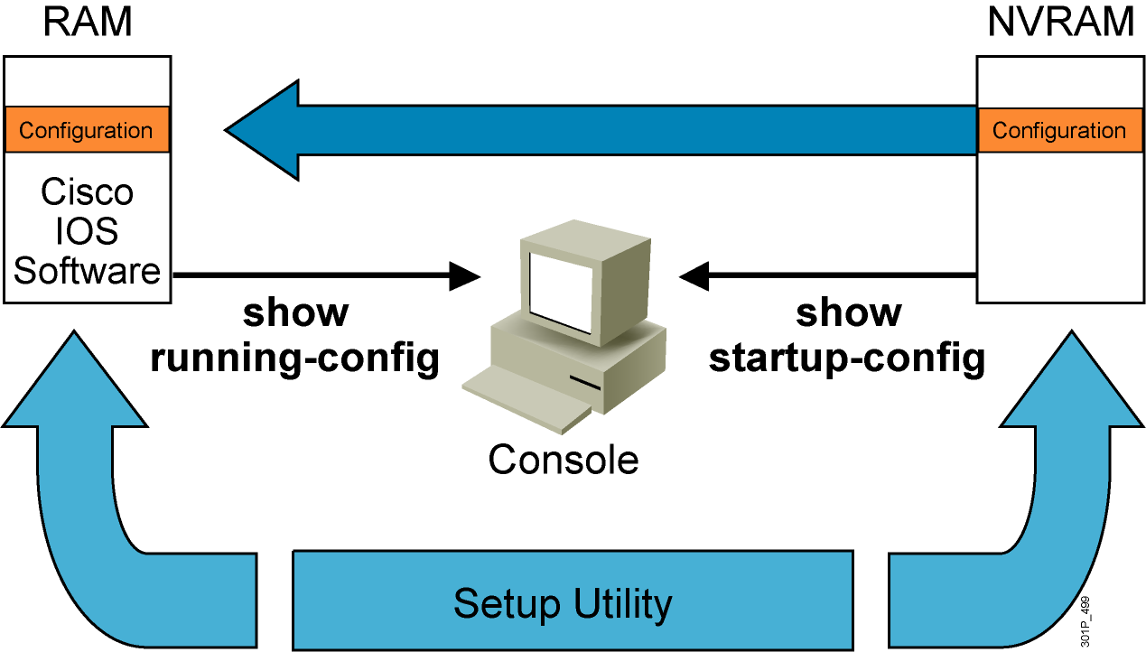
Loading the Configuration
  Load and execute the configuration from NVRAM
  If no configuration is present in NVRAM, enter setup mode
Notes:
Emphasize: Using the default config register value (0x2102), the router will load the config from NVRAM at startup.

Slide 8
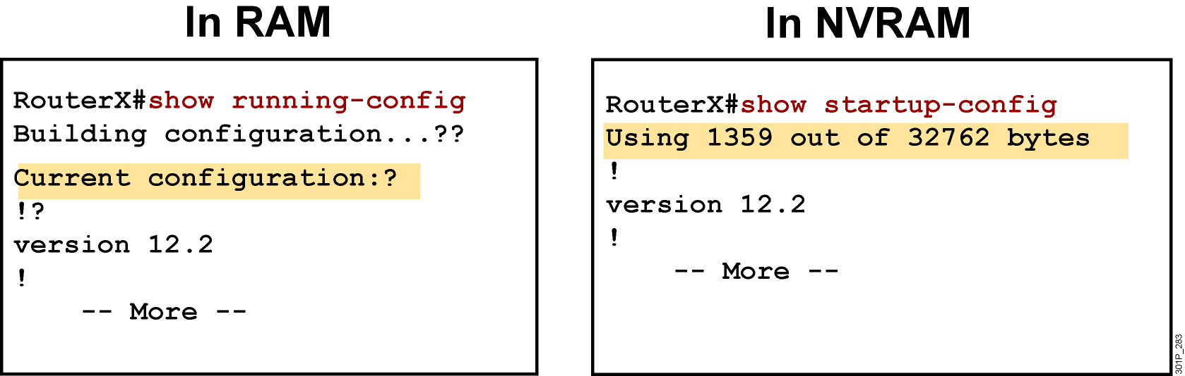
show running-config and show startup-config Commands
  Displays the current and saved configuration
Notes:
Purpose: This slide is a repeated slide from Chapter 4, “Operating and Configuring a Cisco IOS Device.”

Slide 9
Determining the Current Configuration Register Value
Cisco IOS Software, 2800 Software (C2800NM-IPBASE-M), Version 12.4(5a), RELEASE SOFTWARE (fc3)
Technical Support: http://www.cisco.com/techsupport
Copyright (c) 1986-2006 by Cisco Systems, Inc.
Compiled Sat 14-Jan-06 03:19 by alnguyen
ROM: System Bootstrap, Version 12.4(1r) [hqluong 1r], RELEASE SOFTWARE (fc1)
RouterX uptime is 1 week, 5 days, 21 hours, 30 minutes
System returned to ROM by reload at 23:04:40 UTC Tue Mar 13 2007
System image file is "flash:c2800nm-ipbase-mz.124-5a.bin"
Cisco 2811 (revision 53.51) with 251904K/10240K bytes of memory.
Processor board ID FTX1013A1DJ
2 FastEthernet interfaces
2 Serial(sync/async) interfaces
DRAM configuration is 64 bits wide with parity enabled.
239K bytes of non-volatile configuration memory.
62720K bytes of ATA CompactFlash (Read/Write)
Configuration register is 0x2102
Notes:
Emphasize: Use the show version command to display the value of the config register setting. When you change the config register, you will see the change from the show version output:
Configuration register is 0x2102 (will be 0x2142 at next reload).
The new config register value will be used at the next reload.

Slide 10
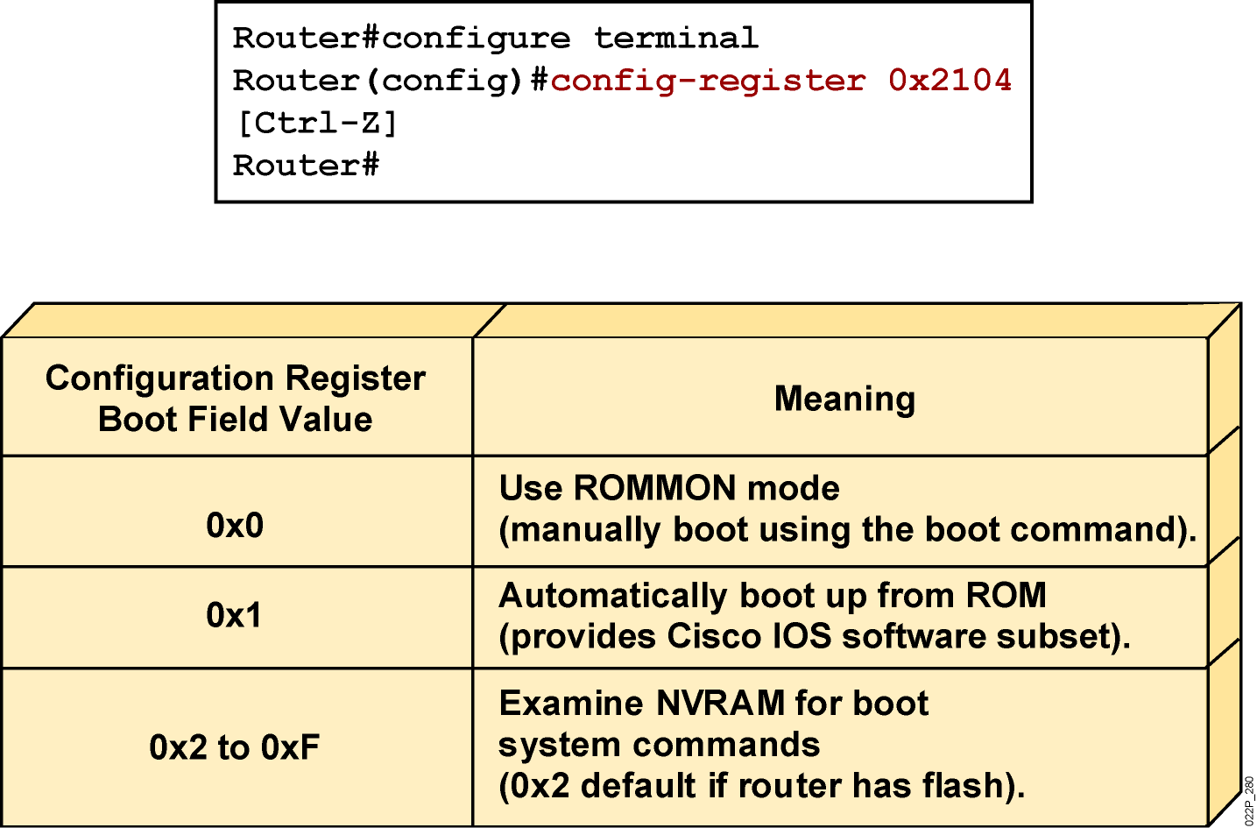
Configuration Register Values
  Configuration register bits 3, 2, 1, and 0 set boot option
  Check the configuration register value with the show version command
Notes:
Layer 4 of 4
Emphasize: Layer 4—Finishes with the third case, a boot field setting in the range of 0x2 to 0xF. The entry of a configuration register value in the 0x2 to 0xF range is significant. When the router attempts to boot from the net (Netboot), the bootstrap program generates a Cisco IOS filename based on the value of the boot field. For example, with the setting 0x2, the default Cisco IOS filename generated will be cisco2-xxxx, where xxxx refers to a processor name (for example, 2500). Again, refer students to the IMCR course for details.
You use the config-register command to change the value.
Notice that the bottom lines of the show version output indicates what value the config register will be on the next reload.

Slide 11
show version Command
Cisco IOS Software, 2800 Software (C2800NM-IPBASE-M), Version 12.4(5a), RELEASE SOFTWARE (fc3)
Technical Support: http://www.cisco.com/techsupport
Copyright (c) 1986-2006 by Cisco Systems, Inc.
Compiled Sat 14-Jan-06 03:19 by alnguyen
ROM: System Bootstrap, Version 12.4(1r) [hqluong 1r], RELEASE SOFTWARE (fc1)
RouterX uptime is 1 week, 5 days, 21 hours, 30 minutes
System returned to ROM by reload at 23:04:40 UTC Tue Mar 13 2007
System image file is "flash:c2800nm-ipbase-mz.124-5a.bin"
Cisco 2811 (revision 53.51) with 251904K/10240K bytes of memory.
Processor board ID FTX1013A1DJ
2 FastEthernet interfaces
2 Serial(sync/async) interfaces
DRAM configuration is 64 bits wide with parity enabled.
239K bytes of non-volatile configuration memory.
62720K bytes of ATA CompactFlash (Read/Write)
Configuration register is 0x2102 (will be 2104 at next reload)
Notes:
Note: The current state of the Flash memory is in read-only mode. It is running Cisco IOS from Flash.
This router has a total of 16 MB of Flash memory. The Flash contains one Cisco IOS image and there is 6.69 MB of available space left in Flash.

Slide 12
show flash Command
RouterX#sh flash
-#- --length-- -----date/time------ path
1 14951648 Feb 22 2007 21:38:56 +00:00 c2800nm-ipbase-mz.124-5a.bin
2 1823 Dec 14 2006 08:24:54 +00:00 sdmconfig-2811.cfg
3 4734464 Dec 14 2006 08:25:24 +00:00 sdm.tar
4 833024 Dec 14 2006 08:25:38 +00:00 es.tar
5 1052160 Dec 14 2006 08:25:54 +00:00 common.tar
6 1038 Dec 14 2006 08:26:08 +00:00 home.shtml
7 102400 Dec 14 2006 08:26:22 +00:00 home.tar
8 491213 Dec 14 2006 08:26:40 +00:00 128MB.sdf
41836544 bytes available (22179840 bytes used)
Notes:
Note: The current state of the Flash memory is in read-only mode. It is running Cisco IOS from Flash.
This router has a total of 16 MB of Flash memory. The Flash contains one Cisco IOS image and there is 6.69 MB of available space left in Flash.

Slide 13
Summary
  When a router boots, it performs tests, finds, and loads software, finds and loads configurations, and finally runs the software.
  The major internal components of a router include RAM, ROM, flash memory, NVRAM, and the configuration register.
  When a router boots, it searches for the Cisco IOS Software image in a specific sequence: location specified in the configuration register, flash memory, a TFTP server,
  and ROM.
  The configuration register includes boot information specifying where to locate the Cisco IOS Software image. The register can be examined with a show command and change the register value with the config-register global configuration command.
Notes:
Purpose: This slide discuss the initial configurations on the routers and switches.
Note: There is no setup mode on the Catalyst 1900 switch.

